Slide 1
Logistic regression
Overview
Maths – intuition

Slide 2
What is logistic regression
Logistic regression is the appropriate regression analysis to conduct when the dependent variable is dichotomous (binary).
Like all regression analyses, the logistic regression is a predictive analysis.
Logistic regression is used to describe the relationship between one dependent binary variable and one or more nominal, ordinal, interval or ratio-level independent variables
In other words, the logistic regression model predicts P(Y=1) as a function of X.

Slide 3
Logistic Regression is a type of classification algorithm
Unlike actual regression, logistic regression does not try to predict the value of a numeric variable given a set of inputs.
Instead, the output is a probability that the given input point belongs to a certain class.
For simplicity, lets assume that we have only two classes, and the probability in question is
  P_+ -> the probability that a certain data point belongs to the ‘+‘ class.
  P_- = 1 - P_+.
Thus, the output of Logistic Regression always lies in [0, 1].

Slide 4
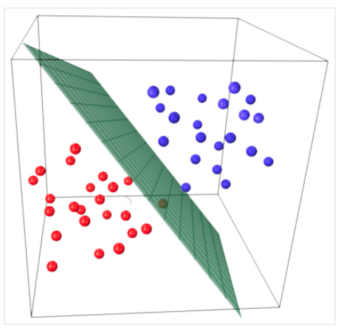
Linearly separable classes
The central premise of Logistic Regression is the assumption that input space can be separated into two nice ‘regions’, one for each class, by a linear boundary.
So what does a ‘linear’ boundary mean?
For 2 dimensions, its a straight line- no curving.
For 3 dimensions, its a plane.
This dividing plane is called a linear discriminant,
  its linear in terms of its function,
  it helps the model ‘discriminate’ between classes.

Slide 5
What is logistic regression
Type of questions that a binary logistic regression can examine.
  How does the probability of getting lung cancer (yes vs. no) change for every additional pound a person is overweight and for every pack of cigarettes smoked per day?
  Do body weight, calorie intake, fat intake, and age have an influence on the probability of having a heart attack (yes vs. no)?
  Should a bank give a person a loan? Yes/ No
  Is an individual transaction fraudulent or not?
  If people are likely to vote for new legislation or not?

Slide 6
What is logistic regression
Continuous Vs categorical variables
General linear regression model : y = b0 + b1.x1 + b2.x2 + e
Independent variables (Xs)
  Continuous : age, income, height, -> use numerical values
  Categorical : gender, ethnicity, sex, status -> use dummy variables
Binary outcomes
  Representing a binary outcome
    YES | NO
    Use dummy variables → YES: 1, NO: 0

Slide 7
Binary logistic regression major assumptions:
The dependent variable should be dichotomous in nature (e.g., presence vs. absent).
There should be no outliers in the data,
  E.g. which can be assessed by converting the continuous predictors to standardized scores, and removing values below -3.29 or greater than 3.29.
There should be no high correlations (multicollinearity) among the predictors.
  This can be assessed by a correlation matrix among the predictors.
At the center of the logistic regression analysis is the task estimating the log odds of an event.
Logistic regression requires quite large sample sizes.

Slide 8
Example
We have data on 1000 random customers from a given city. We want to know what determines their decision to subscribe to a magazine
Subscribe : Indicates if a customer has subscribed to the magazine
Age: Examine how age influences the likelihood of the subscription
Other attributes : …

Slide 9
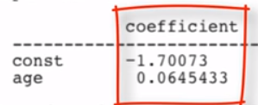
A linear model?
Besides the outcome being binary, there is nothing special about the DV (y, subscribe)
If a customer subscribes, the value of y is higher (from 0 to 1)
We can apply the linear regression:-
  y (subscribe) = β₀ + β₁Age + ε
  y (subscribe) = -1.700 + 0.064 * Age

Slide 10
Interpreting the results
If the DV is binary then the focus should be to see what makes it change from y=0 to y=1
This is also explained as the likelihood of subscription or p (subscribe = 1)
y (subscribe) = -1.700 + 0.064 * Age
P (subscribe = 1) = p = -1.700 + 0.064 * Age
Every additional year of Age, increases the probability of subscription by 6.4units

Slide 11
Problems with the linear approach
Probabilities are bounded, ) 0 =< p =< 1
The range of age in the data is 20 =< age =< 55
The probability that a 35 year old person subscribes is
  y = -1.700 + 0.064 * 35 = 0.54
The probability that a person 25 years or 45 years subscribes?
  y = -1.700 + 0.064 * 25 = -0.09 … possible?
  y = -1.700 + 0.064 * 45 = +1.20

Slide 12
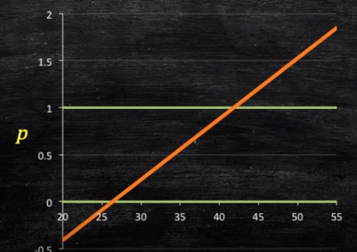
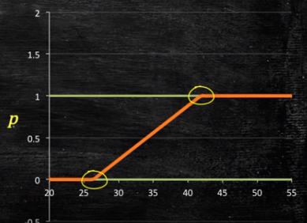
Probability plot
Customers of more than 45 years of age have probability > 1
Customer who are less than 25 years age, the probability is less than 0
Any value> 1.0, can be made 1.0
Any value< 0.0, can be made 0.0

Slide 13
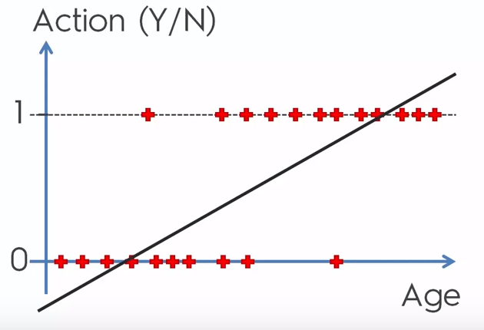
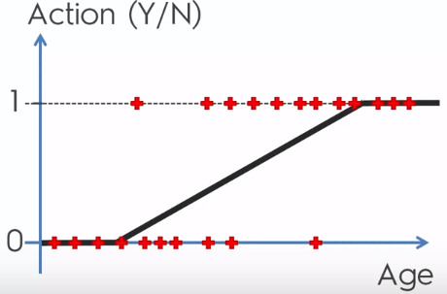
Logistic function - example
Predictor : X : age
Outcome : Action : y :
Depending on age, predict if the person will take the offer or not (ACTION = 1 or 0)

Slide 14
Fixing the issue
We need to somehow constrain p such that 0 ≤ p ≤ 1
We need to ensure
  Probability , p, must always be POSITVE
  It must be ≤ 1

Slide 15
Ways to fix
Absolute of a number p = |X| | Square of a number p = X² | Taking exponentiation p = e^{(β0 + β1Age)}
Solves the ≤ 0 issue Does not solve the >1 issue | Solves the ≤ 0 issue Does not solve the > 1 issue | Solves the ≤ 0 issue Does solve the > 1 issue
 |  | p = e^{(β0 + β1Age)} / [e^{(β0 + β1Age)} + 1]
 |  | p = e^{(β0 + β1Age)} / [e^{(β0 + β1Age)} + 1] 1/p = [e^{(β0 + β1Age)} + 1] / e^{(β0 + β1Age)} 1/p = 1 + 1/ [e^{(β0 + β1Age)} ] 1/p – 1 = 1/ [e^{(β0 + β1Age)} ] (1-p)/p = 1/ [e^{(β0 + β1Age)} ] p/(1-p) = e^{(β0 + β1Age)} ln(p/1-p) = β0 + β1Age
Even though the probability of a customer subscribing (p) is not a linear function of age, the simple transformation is now a linear function of age
Equation for logistic regressions

Slide 16
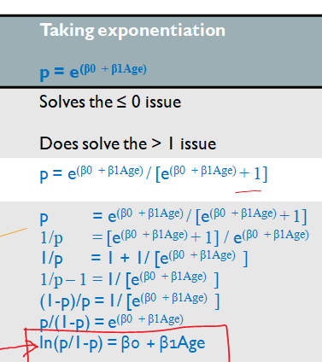

Slide 17
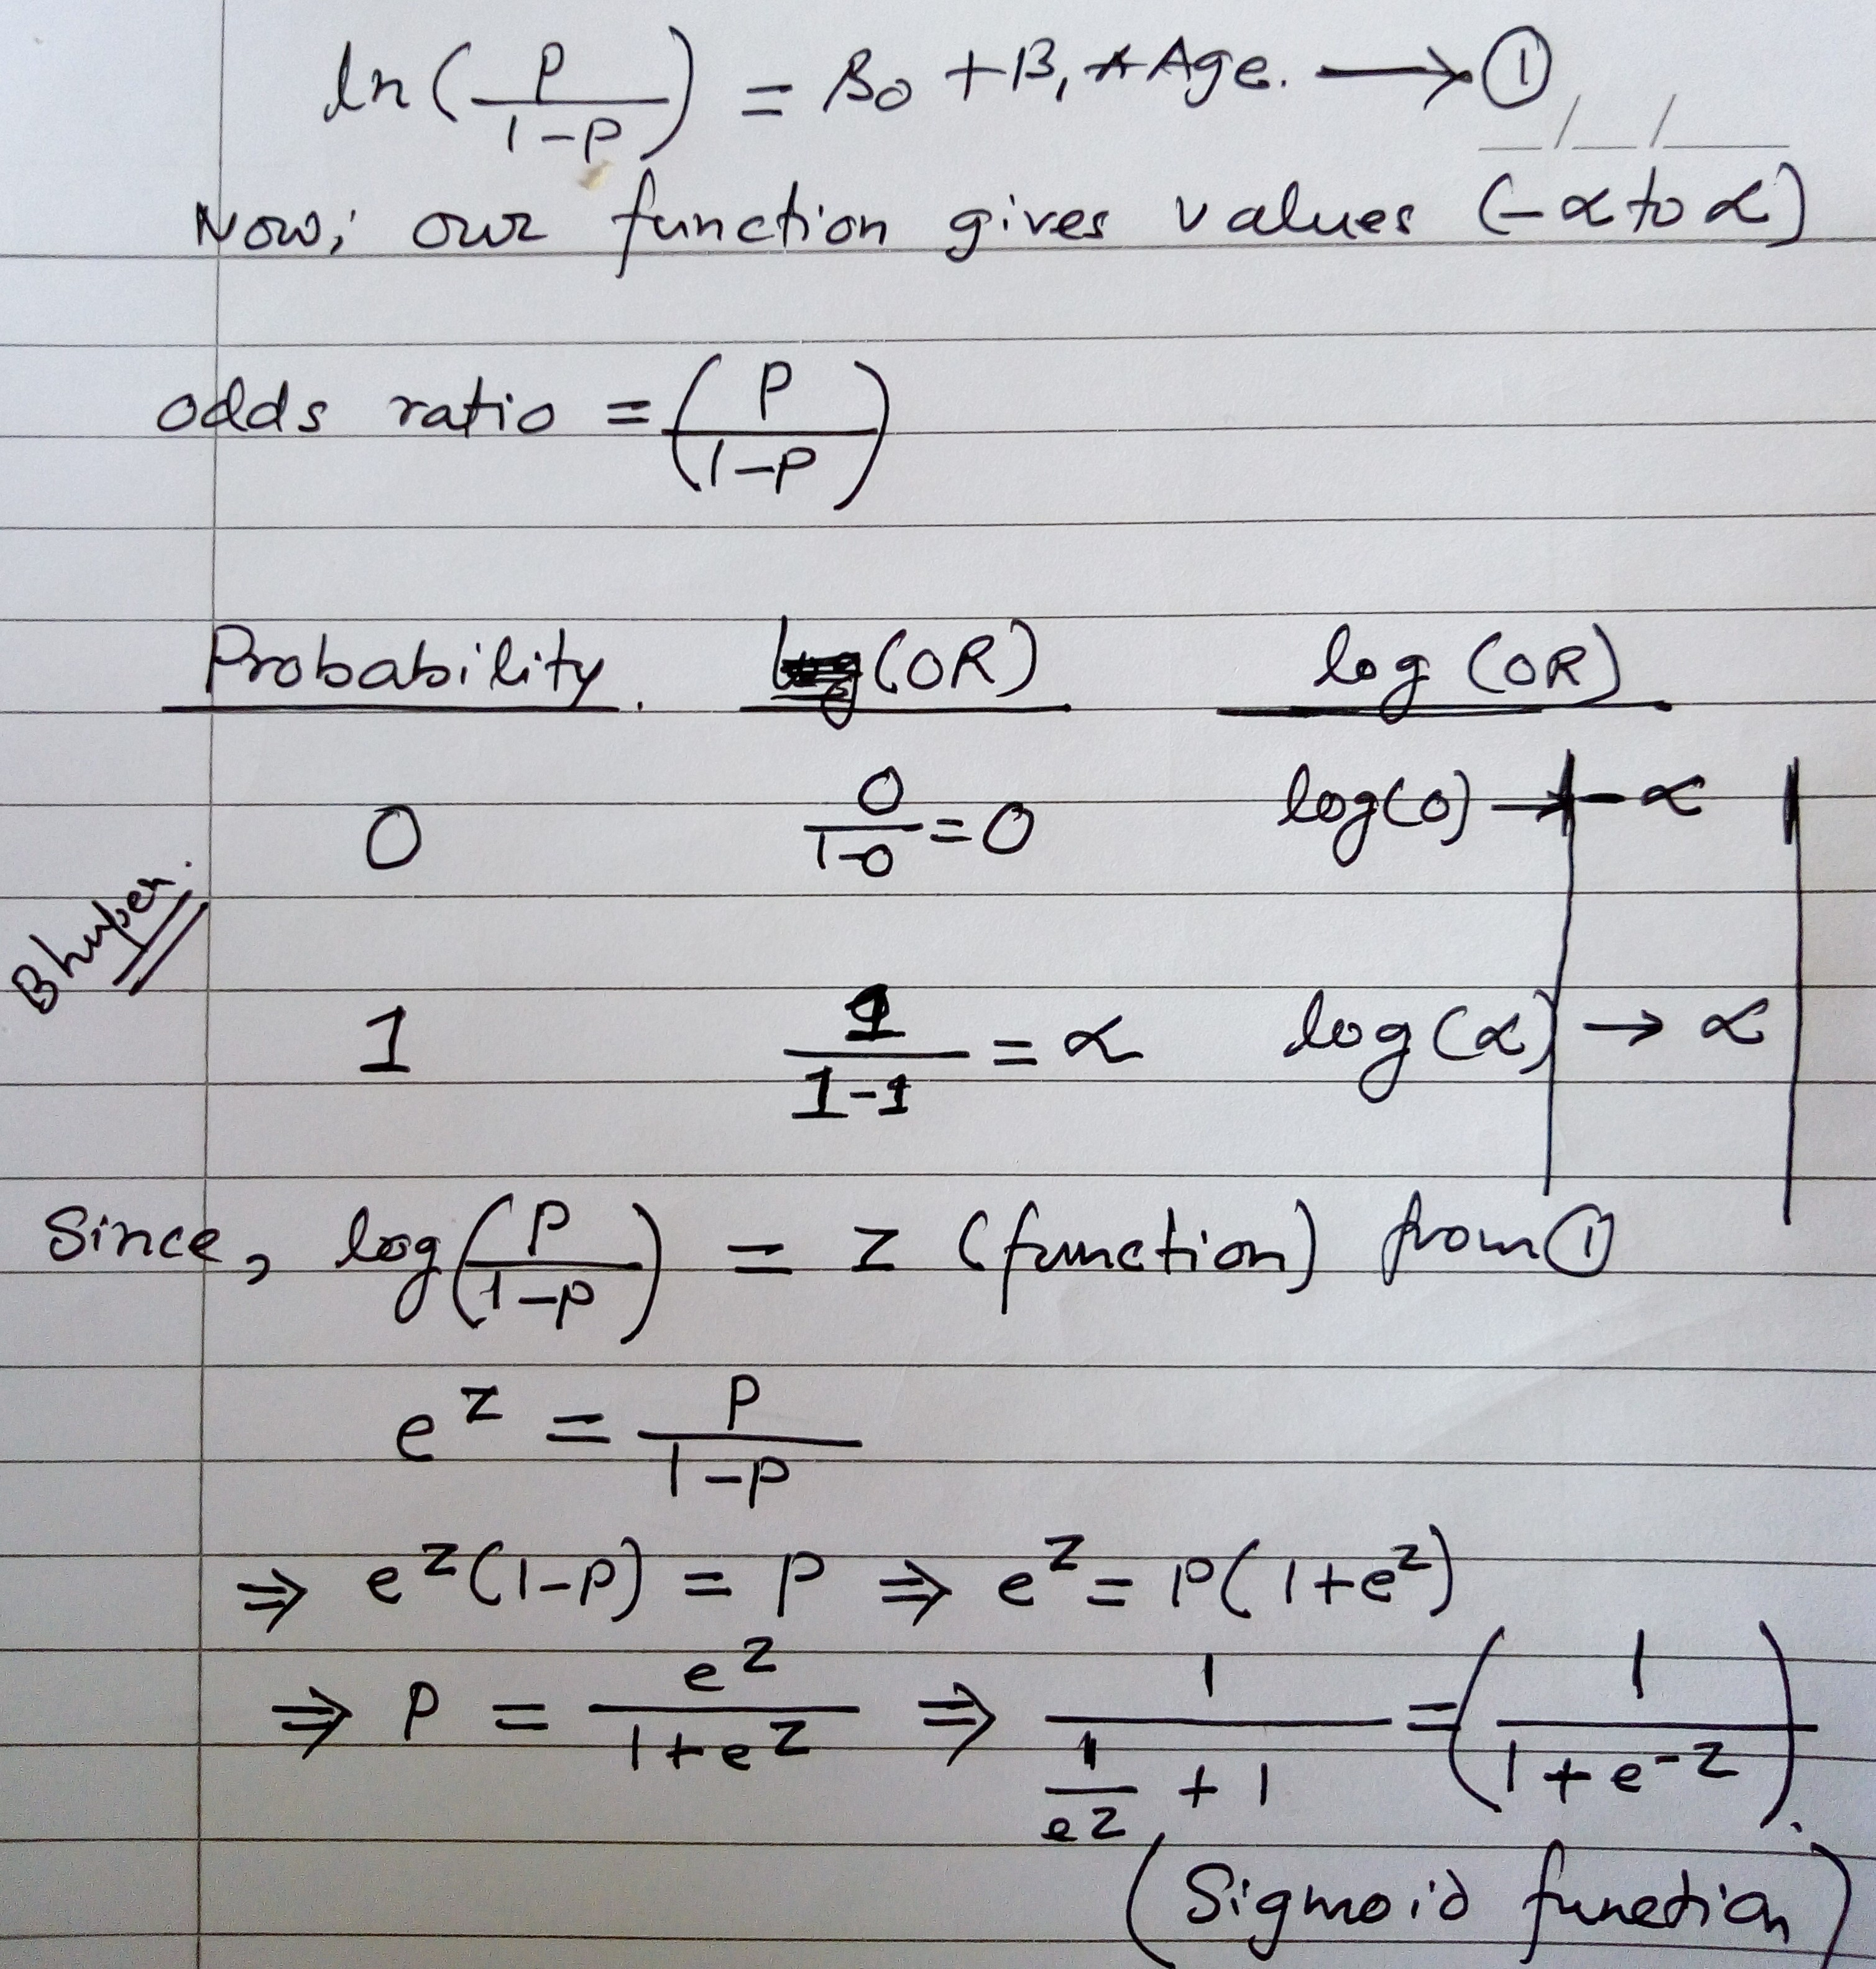
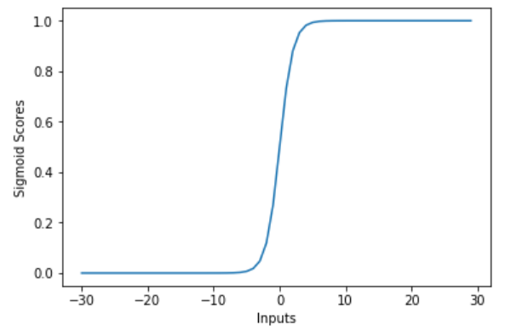
Basically a sigmoid function

Slide 18
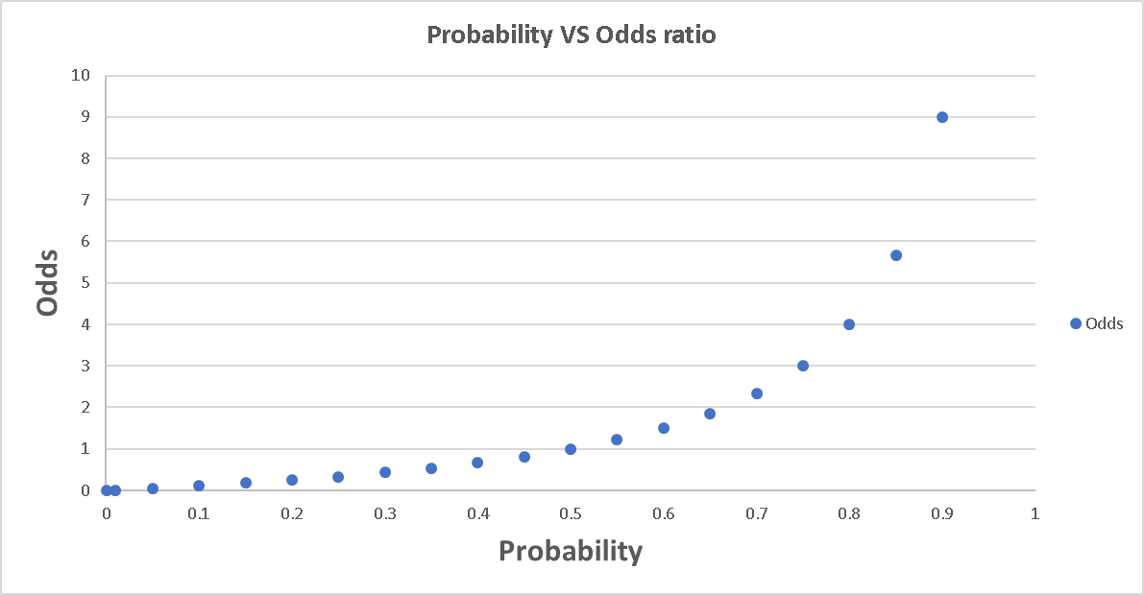
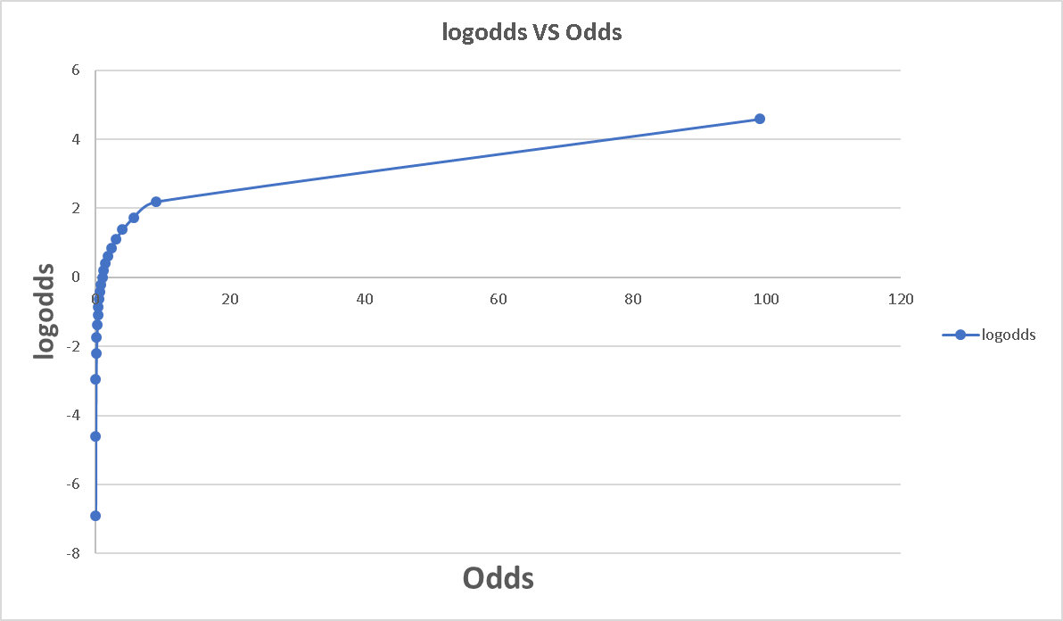
Odds etc
probability | odds | logodds
0.001 | 0.001001001 | -6.906754779
0.01 | 0.01010101 | -4.59511985
0.05 | 0.052631579 | -2.944438979
0.1 | 0.111111111 | -2.197224577
0.15 | 0.176470588 | -1.734601055
0.2 | 0.25 | -1.386294361
0.25 | 0.333333333 | -1.098612289
0.3 | 0.428571429 | -0.84729786
0.35 | 0.538461538 | -0.619039208
0.4 | 0.666666667 | -0.405465108
0.45 | 0.818181818 | -0.200670695
0.5 | 1 | -1.11022E-16
0.55 | 1.222222222 | 0.200670695
0.6 | 1.5 | 0.405465108
0.65 | 1.857142857 | 0.619039208
0.7 | 2.333333333 | 0.84729786
0.75 | 3 | 1.098612289
0.8 | 4 | 1.386294361
0.85 | 5.666666667 | 1.734601055
0.9 | 9 | 2.197224577
0.99 | 99 | 4.59511985
0.999 | 999 | 6.906754779
0.9999 | 9999 | 9.210240367
0.999999 | 999999 | 13.81550956
0.999999999 | 1000000027 | 20.72326586
Why do we take all the trouble doing the transformation from probability to log odds?
One reason is that it is usually difficult to model a variable which has restricted range, such as probability.
This transformation is an attempt to get around the restricted range problem.
It maps probability ranging between 0 and 1 to log odds ranging from negative infinity to positive infinity.

Slide 19
INTERPRET ODDS RATIOS IN LOGISTIC REGRESSION
odds | Log of odds
probability of success of some event is .8. probability of failure 1- .8 = .2. The odds of success are defined as the ratio of the probability of success over the probability of failure. So, the odds of success are .8/.2 = 4 That is to say that the odds of success are 4 to 1. | Log(p/(1-p))
the odds increase as the probability increases or vice versa
Probability ranges from 0 and 1.
Odds range from 0 and positive infinity. | From –infinity to +infinity

Slide 20
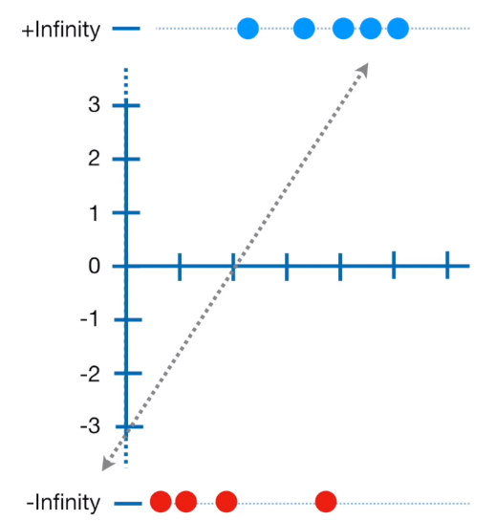
Main points
In linear regression, the line is fit using the values predicated by the regression function.
Instead in log reg, the is fit using an S shape logit function
This S curve is basically a sigmoid function.
The curve tells the probability of a given point, that probability is used to decide the predicated class.
Coefficients are presented using logodds function

Slide 21
Pros and cons
Pros | Cons
Convenient probability scores for observations | Doesn’t perform well when feature/dimensions/columns space is too large
Efficient implementations available across tools | Doesn’t handle large number of categorical features/variables well
Multi-collinearity is not really an issue and can be countered with L2 regularization to an extent | Relies on transformations for non-linear features
Wide spread industry comfort for logistic regression solutions

Slide 22
difference between linear regression and logistic regression
linear regression | logistic regression
In linear regression, the outcome (dependent variable) is continuous. | Binary classification; is used when the response variable is categorical in nature. E.g. yes/no, true/false, red/green
The data is modelled using a straight line. | The probability of some obtained event is represented as a linear function of a combination of predictor variables.
Linear relationship between dependent and independent variables is required | Linear relationship between dependent and independent variables is NOT required
n the linear regression, the independent variable can be correlated with each other. | the variable must not be correlated with each other.

Slide 23
Important Points:
Logistic regression doesn’t require linear relationship between dependent and independent variables. It can handle various types of relationships because it applies a non-linear log transformation to the predicted odds ratio
To avoid over fitting and under fitting, we should include all significant variables.
It requires large sample sizes because maximum likelihood estimates are less powerful at low sample sizes than ordinary least square
The independent variables should not be correlated with each other i.e. no multi collinearity. However, we have the options to include interaction effects of categorical variables in the analysis and in the model.
If the values of dependent variable is ordinal, then it is called as Ordinal logistic regression
If dependent variable is multi class then it is known as Multinomial Logistic regression.

Slide 24
Multinomial Logistic Regression
Binary Classification:
  Given the subject and the email text predicting, Email Spam or not.
  Sunny or rainy day prediction, using the weather information.
  Based on the bank customer history, Predicting whether to give the loan or not.
Multi-Classification:
  Given the dimensional information of the object, Identifying the shape of the object.
  Identifying the different kinds of vehicles.
  Based on the color intensities, Predicting the color type.

Slide 25
Difference Between Sigmoid Function and Softmax Function
Softmax Function | Sigmoid Function
Used for multi-classification in logistic regression model. | Used for binary classification in logistic regression model.
The probabilities sum will be 1 | The probabilities sum need not be 1.
Used in the different layers of neural networks. | Used as activation function while building neural networks.
The high value will have the higher probability than other values. | The high value will have the high probability but not the higher probability.

Slide 26
Comparing Logistic Regression with Other Models
Advantages of logistic regression: | Disadvantages of logistic regression:
Highly interpretable, Outputs well-calibrated predicted probabilities | Presumes a linear relationship between the features and the log-odds of the response
Model training and prediction are fast
No tuning is required (excluding regularization)
Features don't need scaling
Can perform well with a small number of observations

Slide 27
sklearn.linear_model.LogisticRegression
class sklearn.linear_model.LogisticRegression(penalty=’l2’, dual=False, tol=0.0001, C=1.0, fit_intercept=True, intercept_scaling=1, class_weight=None, random_state=None, solver=’warn’, max_iter=100, multi_class=’warn’, verbose=0, warm_start=False, n_jobs=None)
penalty : str, ‘l1’ or ‘l2’, default: ‘l2’
  Used to specify the norm used in the penalization.
C : float, default: 1.0
  Inverse of regularization strength; must be a positive float.
solver : str, {‘newton-cg’, ‘lbfgs’, ‘liblinear’, ‘sag’, ‘saga’}, default: ‘liblinear’.
  Algorithm to use in the optimization problem.
  For small datasets, ‘liblinear’ is a good choice, whereas ‘sag’ and ‘saga’ are faster for large ones.
  For multiclass problems, only ‘newton-cg’, ‘sag’, ‘saga’ and ‘lbfgs’ handle multinomial loss; ‘liblinear’ is limited to one-versus-rest schemes.

Slide 28
sklearn.linear_model.LogisticRegression
class sklearn.linear_model.LogisticRegression(penalty=’l2’, dual=False, tol=0.0001, C=1.0, fit_intercept=True, intercept_scaling=1, class_weight=None, random_state=None, solver=’warn’, max_iter=100, multi_class=’warn’, verbose=0, warm_start=False, n_jobs=None)
  multi_class : str, {‘ovr’, ‘multinomial’, ‘auto’}, default: ‘ovr’
  If the option chosen is ‘ovr’, then a binary problem is fit for each label.

Slide 29
qs
Is Logistic regression mainly used for Regression?
A) TRUE
B) FALSE
Is it possible to apply a logistic regression algorithm on a 3-class Classification problem?
A) TRUE
B) FALSE
Which of the following methods do we use to best fit the data in Logistic Regression?
A) Least Square Error
B) Maximum Likelihood
C) Jaccard distance
D) Both A and B

Slide 30
qs
Which of the following evaluation metrics can not be applied in case of logistic regression output to compare with target?
A) AUC-ROC
B) Accuracy
C) Logloss
D) Mean-Squared-Error
One of the very good methods to analyze the performance of Logistic Regression is AIC, which is similar to R-Squared in Linear Regression. Which of the following is true about AIC?
A) We prefer a model with minimum AIC value
B) We prefer a model with maximum AIC value
C) Both but depend on the situation
D) None of these

Slide 31
qs
Standardisation of features is required before training a Logistic Regression.
A) TRUE
B) FALSE
Suppose you have been given a fair coin and you want to find out the odds of getting heads. Which of the following option is true for such a case?
A) odds will be 0
B) odds will be 0.5
C) odds will be 1
D) None of these

Slide 32
qs
The logit function(given as l(x)) is the log of odds function. What could be the range of logit function in the domain x=[0,1]?
A) (– ∞ , ∞)
B) (0,1)
C) (0, ∞)
D) (- ∞, 0)

